Slide 1
Bapatla Engineering College::Bapatla
(Autonomous)
Department of Information Technology
Internal Project Review
Under the Esteemed Guidance of
Dr. B.Krishnaiah

Slide 2
Batch Members
M.SHANKAR-Y22AIT475
N.SIVA KUMARI-Y22AIT484
Y.JITENDRA-Y22AIT527
P.LALITHA-Y22AIT490

Slide 3
Title
AI BASED PRODUCT DEMAND AND SALES TREND ANALYSIS FOR SUPER MARKET

Slide 4
Table of Contents
Abstract
Introduction
Problem Statement
Literature Survey
Existing System
Proposed System
System Architecture
Flow Chart
Modules
Methodology
Algorithm Working
Implementation or Snapshots
Requirements
Future Enhancements
Conclusion

Slide 5
Abstract
The rapid growth of the retail industry has led to the generation of a large amount of sales data through daily supermarket transactions, making it difficult to manually analyze sales patterns and predict future product demand. The main objective of this project is to develop a Supermarket Sales Prediction System that can analyze historical sales data and fore cast the demand for different products in the coming months. By understanding past sales patterns, supermarkets can make better decisions related to product stocking, inventory management, and sales planning. In this project, a web-based application is developed using the Flask Web Framework, which provides an interactive interface for managing sales, products, categories, and reports efficiently. The system allows users to record daily sales transactions and maintain product information in organized manner. The system includes an AI-based prediction module consisting of components such as Sales Predictor and Sale Analyzer, which analyze historical sales data and generate predictions about future product demand. By applying Predictive Analytics, the system vi can estimate the number of items that may be sold in the upcoming days or months. The application also supports CSV and Excel file uploads , allowing users to import and analyze external datasets easily.

Slide 6
Introduction
The retail industry is rapidly growing, and supermarkets generate a large amount of sales data through daily transactions. Analyzing this data manually is difficult and time-consuming. To overcome this problem, modern technologies such as Artificial Intelligence (AI) and Machine Learning (ML) are used to analyze sales patterns and predict future product demand. Supermarkets often face challenges such as overstocking or stock shortages due to inaccurate demand forecasting. Predicting product demand in advance helps store managers maintain proper inventory levels, reduce waste, and improve customer satisfaction. AI-based systems can analyze historical sales data, identify trends, and provide accurate predictions about future sales.

Slide 7
Problem Statement
Supermarkets generate a large volume of sales data every day due to numerous customer transactions and a wide variety of products. However , analyzing this data manually to understand sales trends and predict future demand is a challenging and time-consuming task. Without proper analysis, supermarkets often face problems such as overstocking of products, shortage of essential items, poor inventory management, and financial losses . Traditional methods of estimating future sales are usually based on assumptions or past experience rather than systematic data analysis, which may lead to inaccurate predictions. Therefore, there is a need for an efficient system that can analyze historical sales data and provide reliable predictions about future product demand. The main problem addressed in this project is to develop a Supermarket Sales Prediction System that uses data analysis and machine learning techniques to study past sales data and predict the number of items likely to be sold in the coming months, and support better decision-making.

Slide 8
Literature Survey
Introduction
The retail industry generates a large amount of sales data through daily transactions. Analyzing this data helps businesses understand customer purchasing behavior and improve decision-making. Researchers have applied various data mining, machine learning, and statistical techniques to predict future sales and demand. Sales prediction systems help supermarkets manage inventory, reduce product wastage, and improve operational efficiency. This chapter reviews previous studies and techniques used in sales forecasting and retail data analysis.
Sales Forecasting in Retail Industry:
Sales forecasting is widely used in retail businesses to estimate future product demand. Researchers have developed different forecasting techniques based on historical sales data. Traditional methods use statistical approaches such as moving averages and time-series analysis to estimate future sales trends. These methods analyze past data patterns to identify seasonal demand and customer purchasing trends. Sales forecasting helps supermarkets maintain optimal inventory levels and avoid problems such as stock shortages or overstocking

Slide 9
Machine Learning for Sales Prediction:
Machine learning techniques have been widely used in sales prediction because they can learn patterns from historical data and generate accurate predictions. Algorithms such as Linear Regression, Decision Trees, and Random Forest are commonly used for forecasting product demand. These models analyze different features such as product category, sales quantity, and time period to identify relationships in the data. Machine learning models improve prediction accuracy by continuously learning from large.
Data Mining Techniques in Retail Analysis:
Data mining techniques are used to extract useful information from large retail datasets. These techniques help identify frequent purchasing patterns, customer preferences, and product relationships. Methods such as association rule mining and clustering are used to group similar products and analyze purchasing behavior. By applying data mining techniques, supermarkets can understand which products are frequently purchased together and optimize their product placement and marketing

Slide 10
Visualization and Decision Support Systems:
Data visualization plays an important role in understanding sales trends and prediction results. Visualization tools such as charts, graphs, and dashboards help managers easily interpret complex datasets. Decision support systems combine data analysis and visualization to assist managers in making better decisions related to inventory management and sales planning. These systems provide clear insights into sales performance and future demand.
AI-Based Decision Support Systems:
Artificial Intelligence (AI) has been increasingly integrated into business management systems to support decision-making processes. AI-based modules such as Sales Predictors and Sales Analyzers can automatically process large volumes of transaction data and generate insights about future demand patterns. These systems use predictive algorithms and analytical techniques to provide recommendations for inventory management and sales planning. Studies show that AI-driven decision support systems help organizations reduce operational risks, optimize resource allocation, and improve overall business

Slide 11
Existing System
The existing system in supermarkets mainly relies on manual methods or basic software tools to manage sales and inventory. Sales data is recorded through billing systems and stored in databases, but there is very limited analysis of this data. Most supermarkets depend on past experience or simple calculations to estimate product demand, which is often inaccurate.
In the current system, there is no use of advanced technologies like Artificial Intelligence or Machine Learning for predicting future sales. As a result, supermarkets frequently face problems such as overstocking, stock shortages, and poor inventory management.
The lack of proper data analysis also makes it difficult to identify sales trends and customer purchasing patterns . Additionally, generating reports and analyzing sales performance is time-consuming and requires manual effort. This reduces efficiency and may lead to incorrect business decisions.

Slide 12
The proposed system is a Sales Management and Supermarket Sales Prediction System developed using a web-based architecture. The system is designed to manage supermarket sales data and analyze it to predict future product demand. It integrates web technologies, database management, and machine learning techniques to provide an intelligent platform for sales monitoring and forecasting. The system allows administrators to manage products, categories, and sales transactions93.2 System Architecture 10through an interactive dashboard. In addition, the system includes an AI prediction module that analyzes historical sales data and generates predictions for future sales trends. This helps supermarket managers improve inventory planning and make better business decisions.
Proposed System

Slide 13
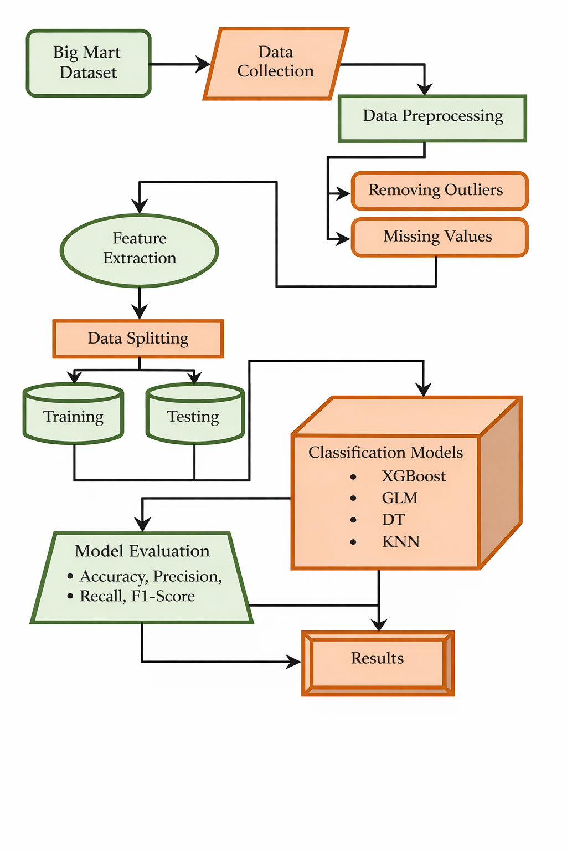
System Architecture
The system follows a multi-layer architecture that includes the Presentation Layer, Application Layer, Business Logic Layer, AI Prediction Layer, and Database Layer. The Presentation Layer consists of web pages such as dashboard, products page, categories page, and reports page where users interact with the system. The Application Layer, developed using the Flask framework, handles user requests and routes them to appropriate modules. The Business Logic Layer processes sales management functions such as product management, category management, and report generation. The AI Prediction Layer includes modules like Sales Predictor and Sale Analyzer that analyzes historical sales data and forecast future sales. Finally, the Database Layer stores all data related to products, categories, and sales transactions using Tiny DB.

Slide 14
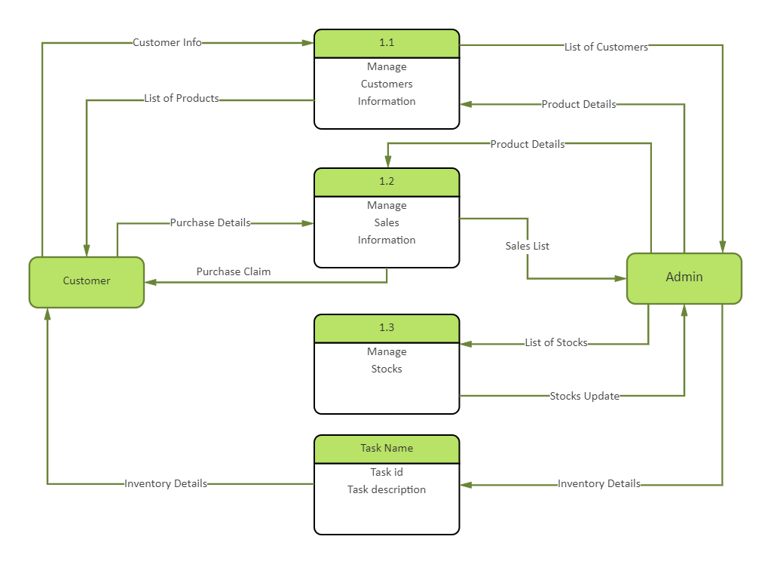
Flow Chart

Slide 15
Modules Used
1. Admin Login Module
This module allows the administrator to securely log into the system using a username and password. After successful authentication, the admin can access all system functionalities such as product management, sales data entry, and report generation.
2. Product Management Module
In this module, the admin can add, update, delete, and view product details. It helps maintain accurate product information such as product name, category, price, and stock availability.
3. Category Management Module
This module allows the admin to create and manage different product categories. Organizing products into categories helps in better management and analysis of sales data.
4. Sales Data Management Module
This module is responsible for storing and managing daily sales transactions. The system records product sales information which is later used for analysis and prediction.
5. Reports and Dashboard Module
The system generates sales reports and displays them through dashboards. These reports help the admin understand sales performance, product demand, and sales trends.
6. AI Prediction Module
This is the core module of the system. It analyzes historical sales data using Artificial Intelligence or Machine Learning algorithms to predict future product demand and sales trends.

Slide 16
Methodology
The methodology of the AI Based Product Demand and Sales Trend Analysis for Super Market project involves several steps to analyze sales data and predict future product demand. First, historical supermarket sales data is collected from the database. The collected data is then preprocessed by removing missing values, duplicates, and formatting the data properly. Important features such as product category, sales quantity, price, and transaction date are selected for analysis. The dataset is divided into training and testing data to build and evaluate the machine learning model. The training data is used to train the AI model to identify patterns and trends in sales data. After training, the model predicts future product demand based on historical sales patterns. Finally, the predicted results are displayed through reports or dashboards, helping supermarket managers make better decisions for inventory management and sales planning.

Slide 17
Algorithm
The AI Based Product Demand and Sales Trend Analysis for Super Market system uses machine learning algorithms to analyze historical sales data and predict future product demand. The main algorithm used in this project is XG Boost (Extreme Gradient Boosting), which is a powerful machine learning technique for prediction and regression problems. XG Boost works by combining multiple decision trees to improve prediction accuracy and reduce errors. It analyzes patterns in past sales data such as product demand, seasonal trends, and customer purchasing behavior to generate accurate sales forecasts. In addition to XG Boost, algorithms like Decision Tree, K-Nearest Neighbors (KNN), and Generalized Linear Model (GLM) can also be used to compare performance and improve prediction results. These algorithms help the system learn from historical data and provide reliable predictions for future sales trends.

Slide 18
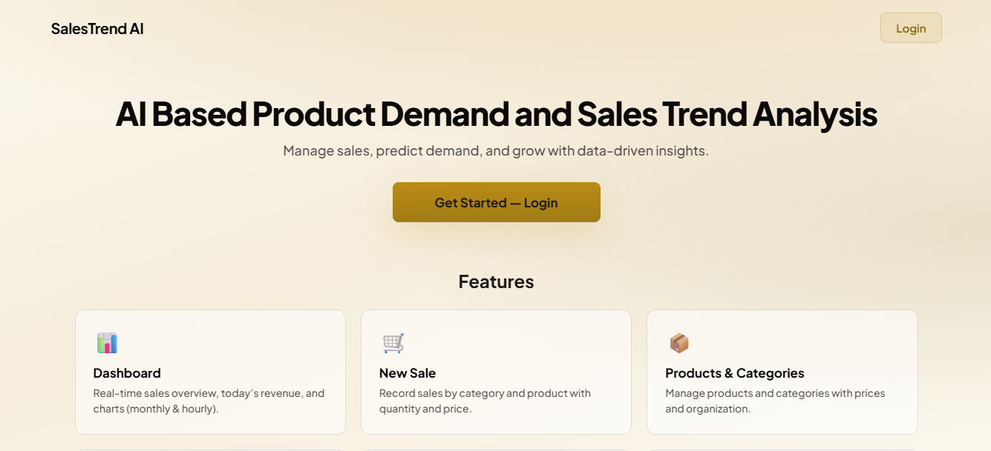
Snapshots

Slide 19
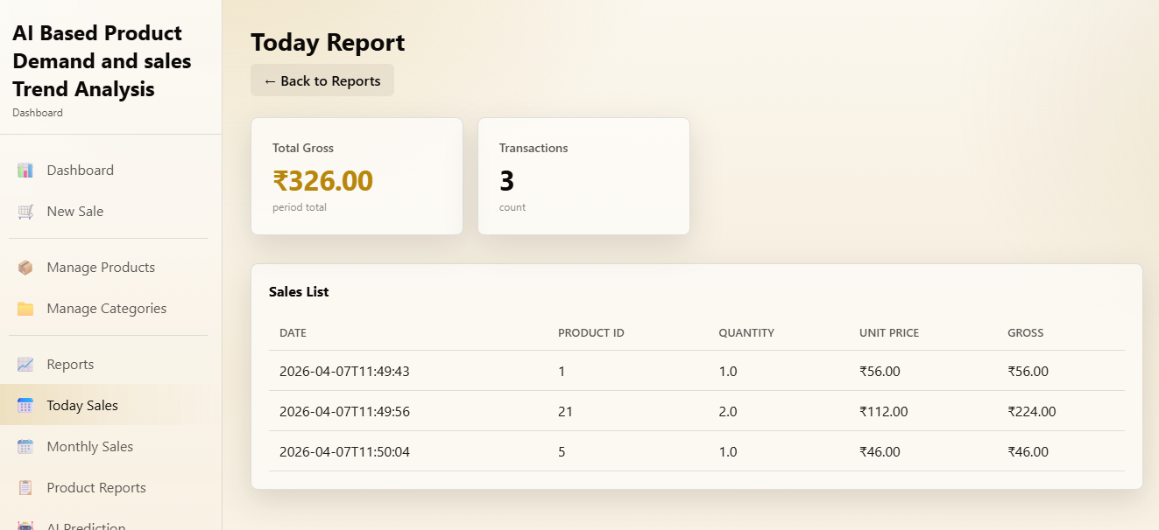

Slide 20
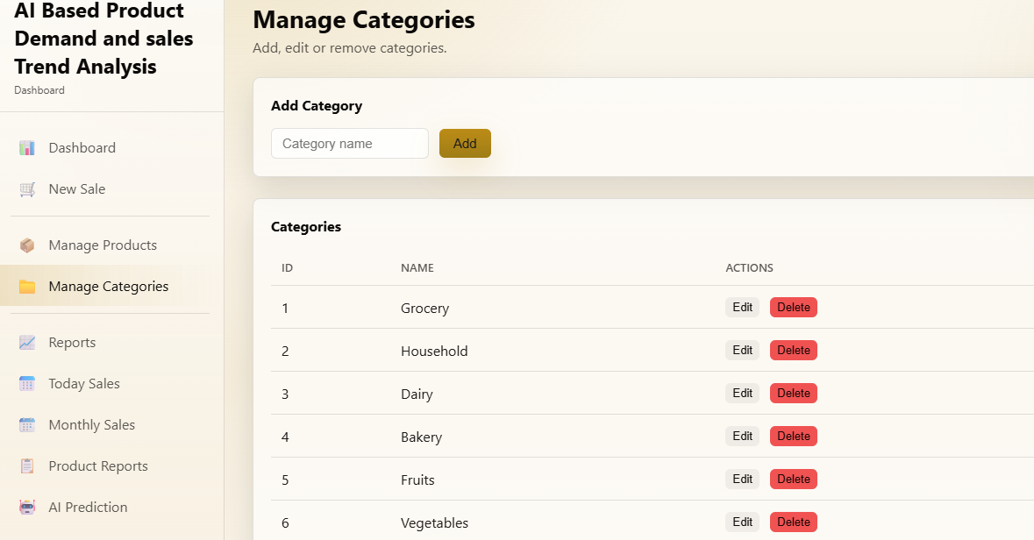

Slide 21
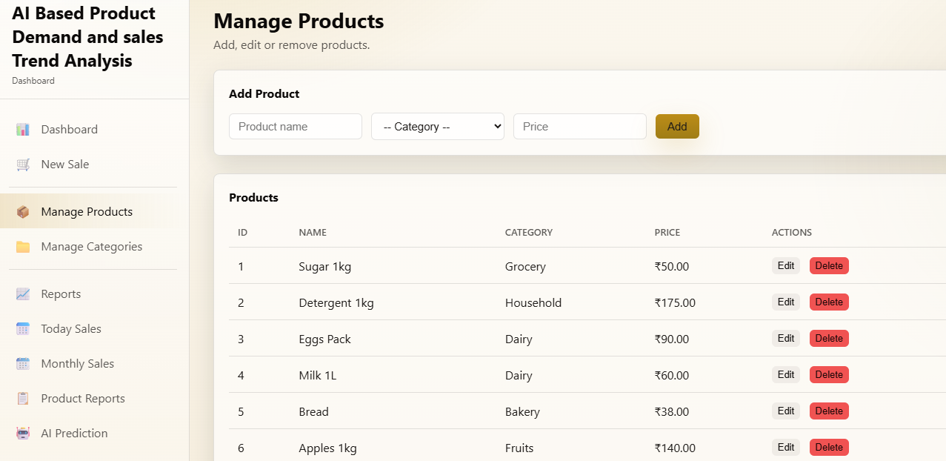

Slide 22
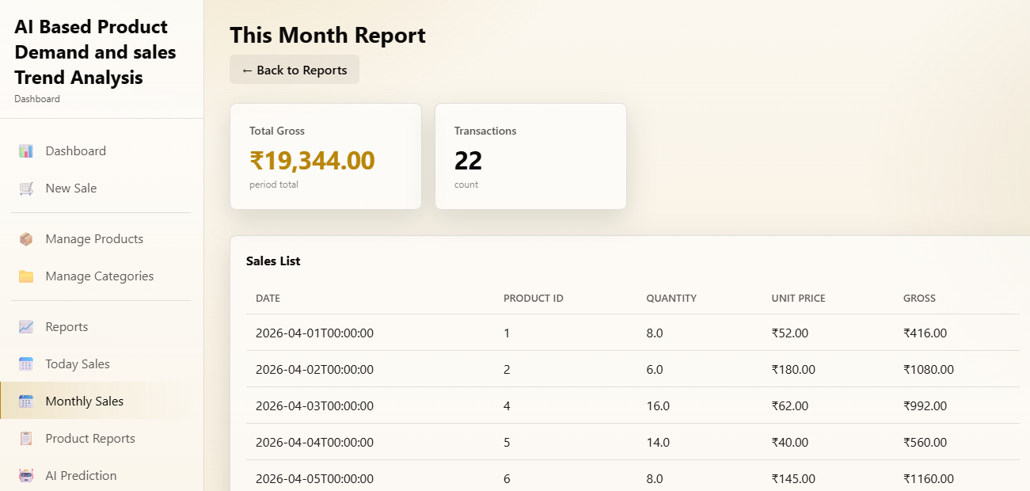

Slide 23
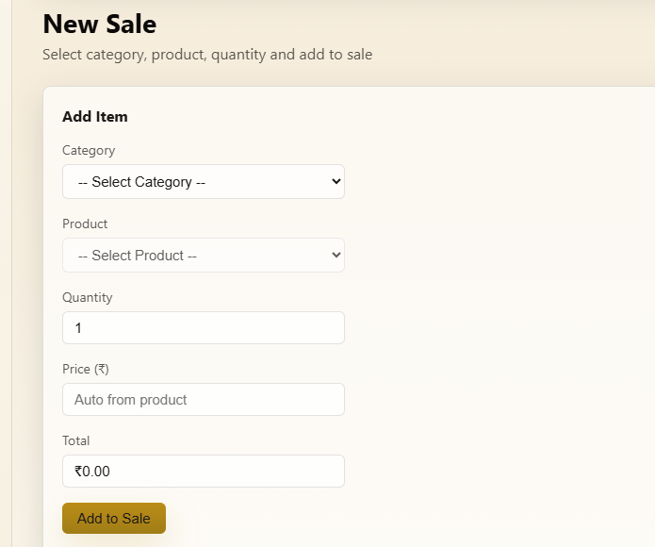

Slide 24
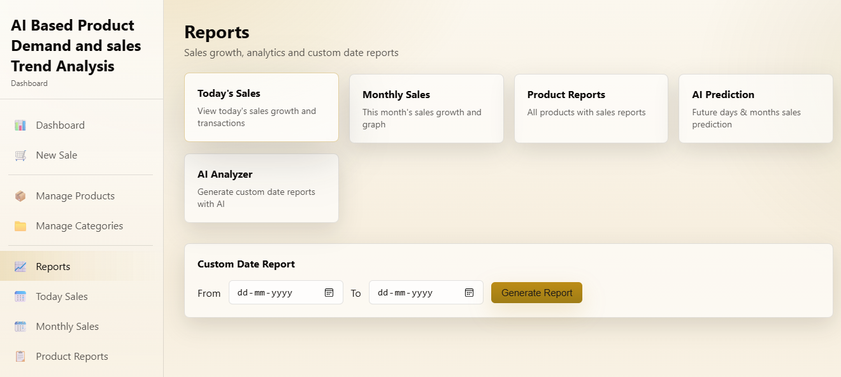

Slide 25
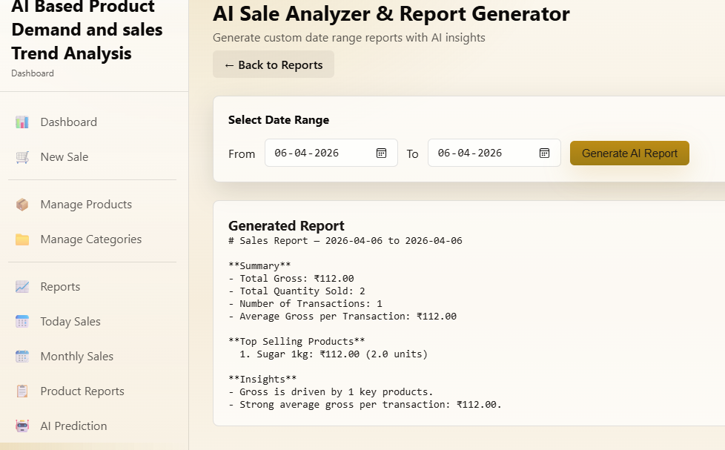

Slide 26
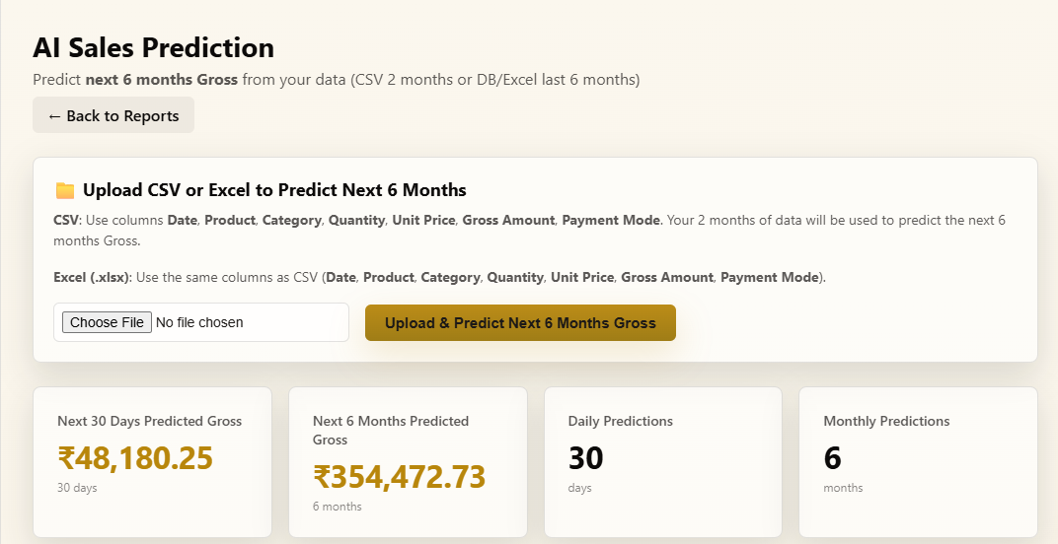

Slide 27
Requirements
1. Hardware Requirements
Processor: Intel Core i3 or above
RAM: Minimum 4 GB
Hard Disk: 500 GB or above
System: Laptop / Desktop Computer
2. Software Requirements
Operating System: Windows 10 / Windows 11
Programming Language: Python
IDE / Tools: Jupyter Notebook / VS Code / Anaconda
Database: MySQL / CSV Dataset
Libraries: Pandas, NumPy, Matplotlib, Scikit-learn, XGBoost

Slide 28
Conclusion
The AI Based Product Demand and Sales Trend Analysis for Super Market system helps supermarkets analyze historical sales data and predict future product demand using Artificial Intelligence techniques. The system collects sales data, processes it, and applies machine learning algorithms to identify patterns and trends in customer purchasing behavior. By predicting future sales, the system helps store managers maintain proper inventory levels, reduce stock shortages, and avoid overstocking. This improves business decision-making and increases operational efficiency. Overall, the proposed system provides an intelligent solution for better sales forecasting and effective supermarket management.

Slide 29
Any Suggestions?

Slide 30


